Slide 1
BUSINESS PROPOSAL FOR
BUG BOTTLE
December 12th, 2025
Presented By
SINDID HOSSAIN (232-35-100)
AFRIM HOSSEN KHAN (232-35-076)
SM NIHAL AHMED (232-35-002)
UMMY SAWDA (241-35-520)
AFRIN JAHAN HAQUE TONNY (232-35-755)
AYSHA AKTHER (232-35-741)

Slide 2







PROBLEM STATEMENT
1 Coil
75 - 137 cigarettes
Liquid Mosquito Vaporizers
1 To 18 Years Old
Potential Carcinogenic Risk

Slide 3




SOLUTION

Slide 4
SOLUTION PRODUCT
Funnel
Upper Body
Lower Body (removable)
Liquid With Fragrance and Sugar

Slide 5





L-R-E-T-S
Launch
Reduce
Efficiency
Trust
Scale

Slide 6


BUSINESS MODEL
The Core Of Our Business Model Is To Sell Refill Packs

Slide 7
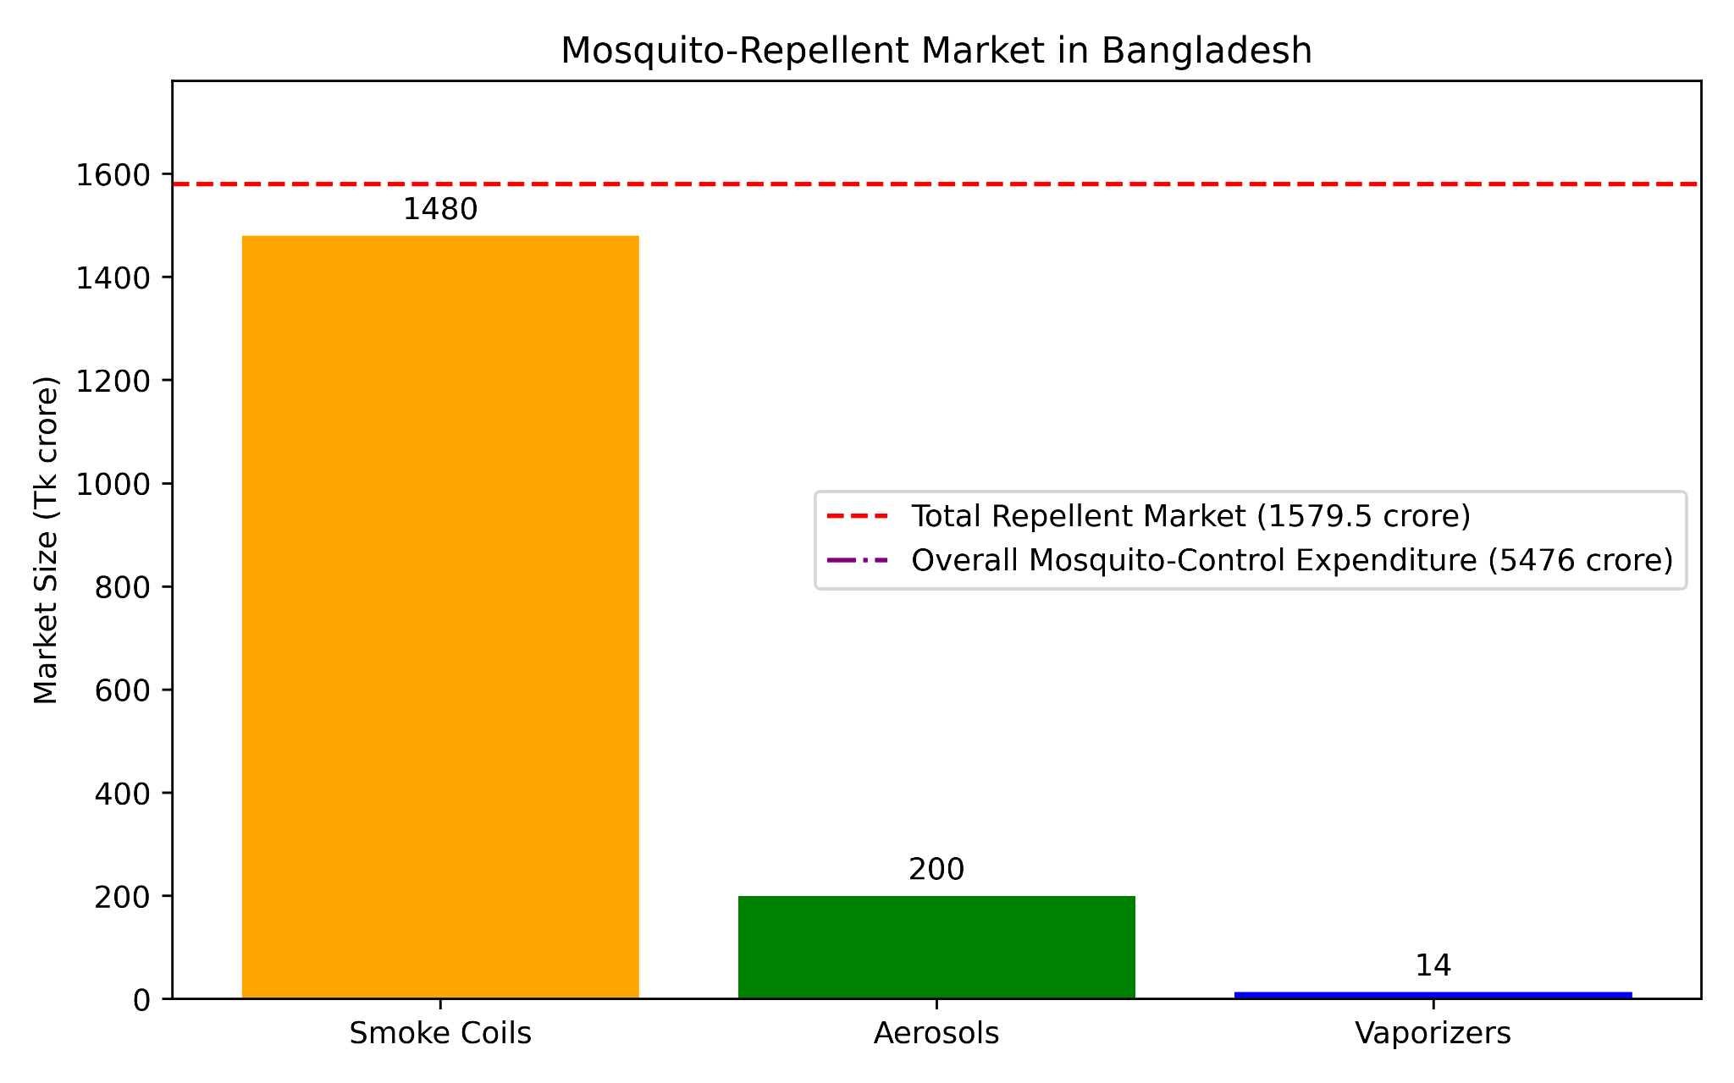
MARKET ANALYSIS

Slide 8
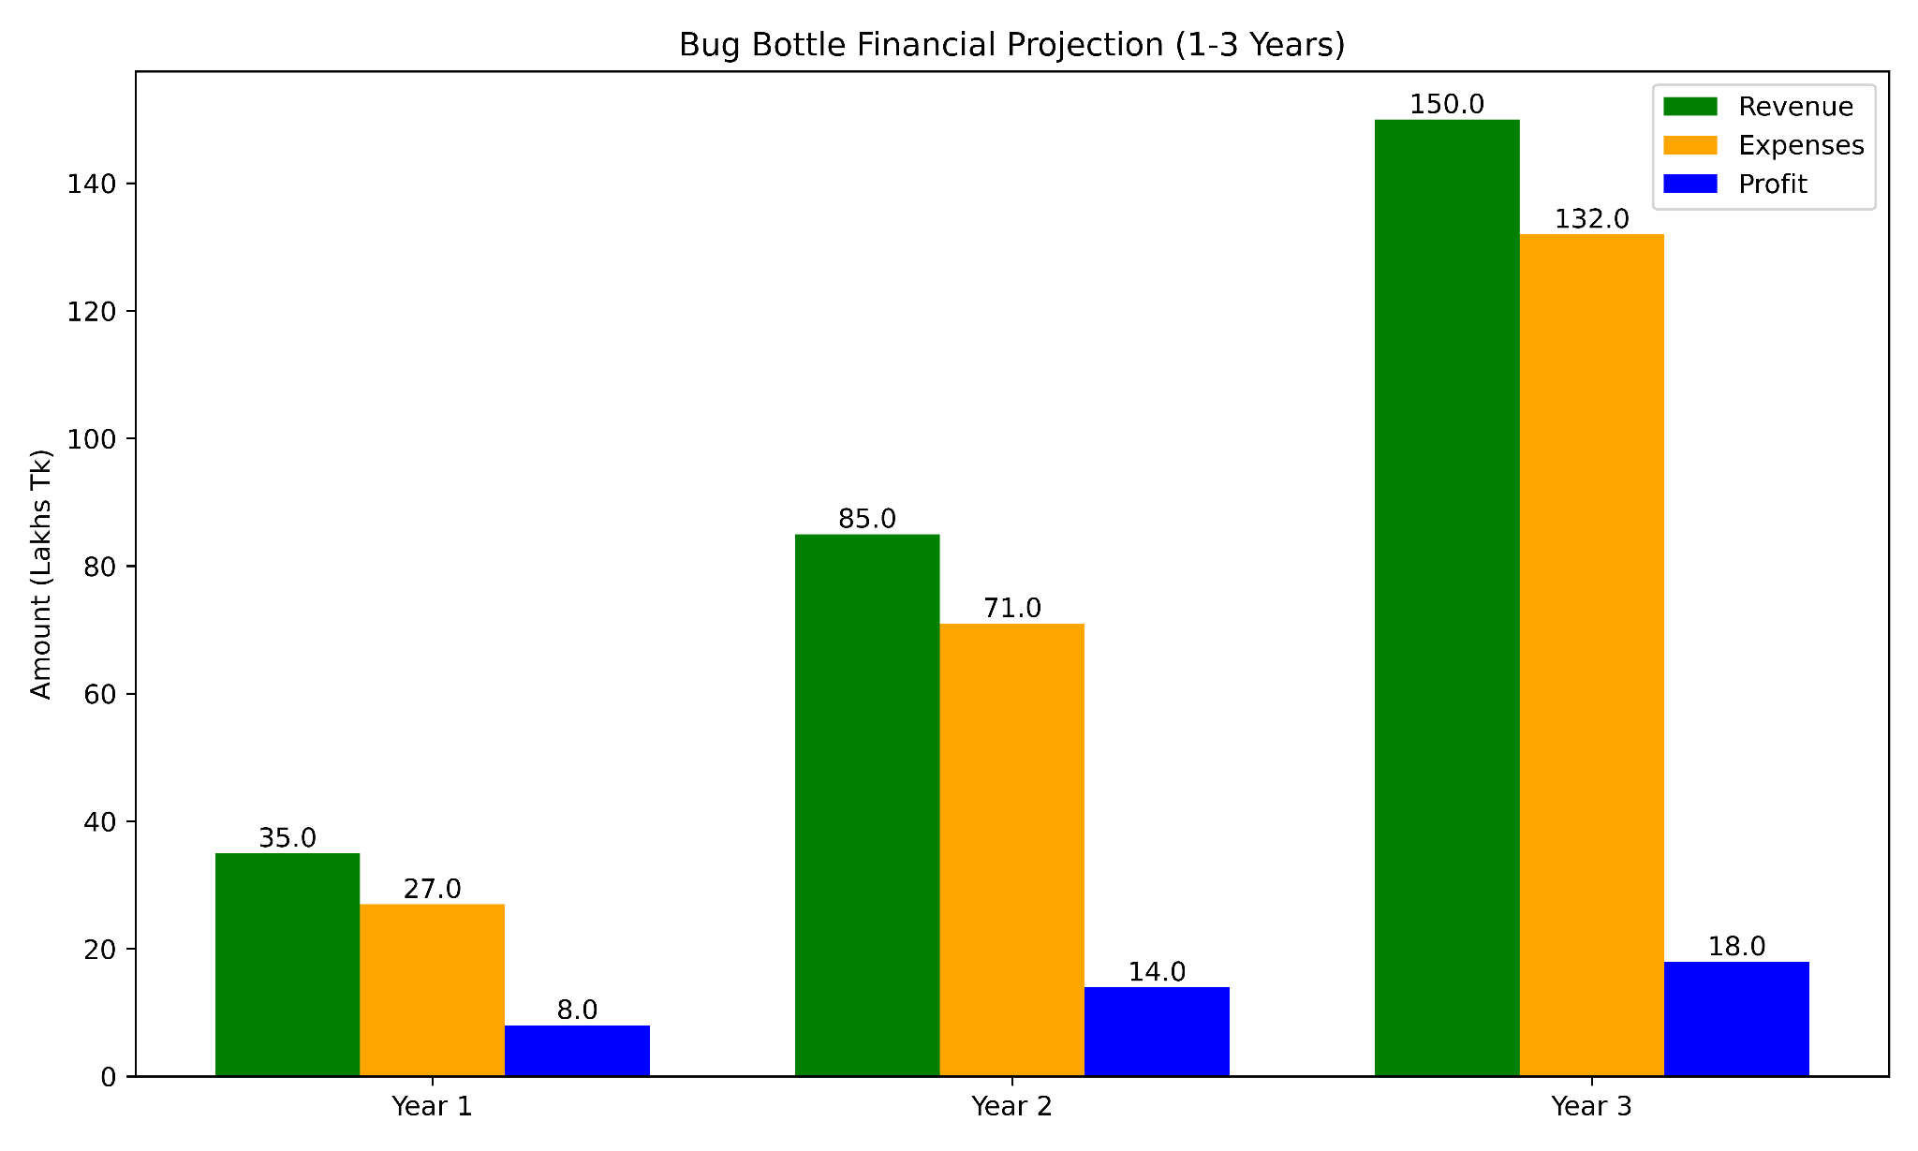
FINANCIAL PLAN

Slide 9
RISK ANALYSIS CYCLE
Competition & Pricing
Quality
& Safety
Market Adoption
Seasonal
Demand

Slide 10

THANK YOU

